Slide 1
Intro to micro:bit
Blink a led
Cindy stenger

Slide 2
Review of micro:bit
The BBC micro:bit is a pocket-sized computer
It helps students see how SW and HW work together
It is programmable
LED light display
Buttons
Sensors
i/o features

Slide 3



Input/processor/output
The micro:bit helps you understand how computers work
Input devise – buttons on micro:bit (keyboard on laptop)
Processor – takes input information and makes something happen on output – like blink a LED
Output devise – Blink a LED on micro:bit (printer or computer display on laptop)

Slide 4
Problem statement:
Make a circuit and create a program that will blink a LED on and off. The LED should be on for one half of a second and then off for one half of a second. The LED will blink continuously until the micro:bit is turned off.

Slide 5
Program design:
We need to perform four tasks in our program based on the problem statement.
#1 Turn the LED on
#2 Wait one half of a second
#3 Turn the LED off
#4 Wait one half of a second

Slide 6
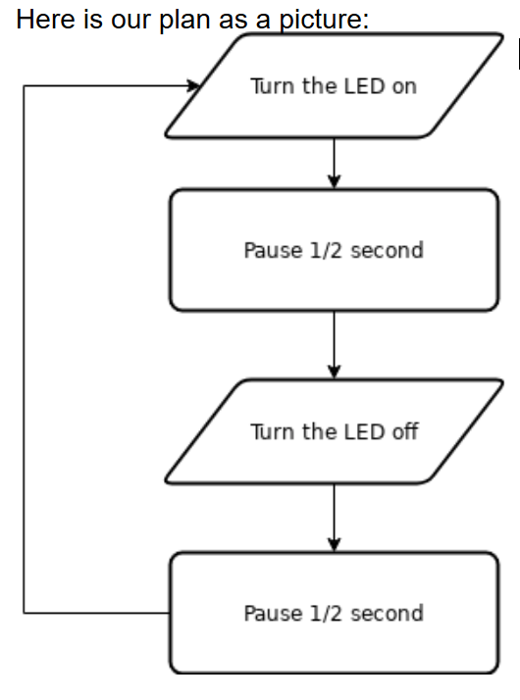
Flowchart
This is our overall plan.
Next, we will write it as code

Slide 7
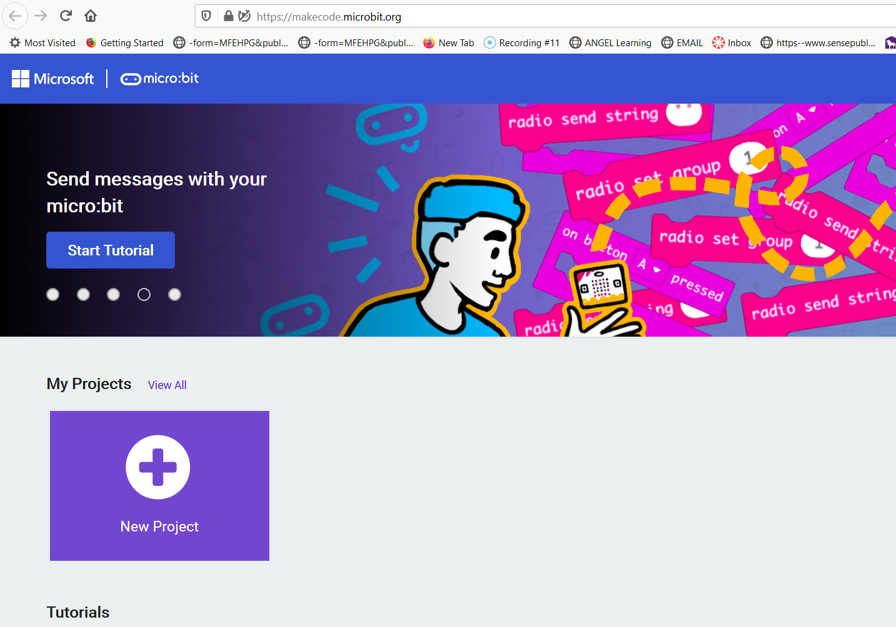
This is where you go to write your program.
MakeCode https://makecode.microbit.org
Click on New Project

Slide 8
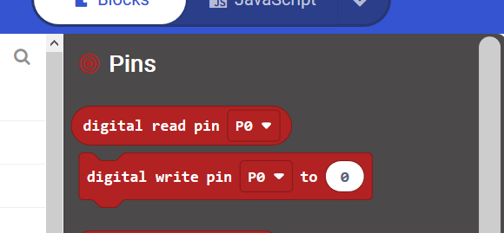
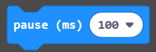
Steps to implement flowchart in block code
Drag start to trash
Go to the advanced drawer and find PINS and grab
Digital write pin P0 to 0
Next
Go to the basic drawer to get a pause

Slide 9
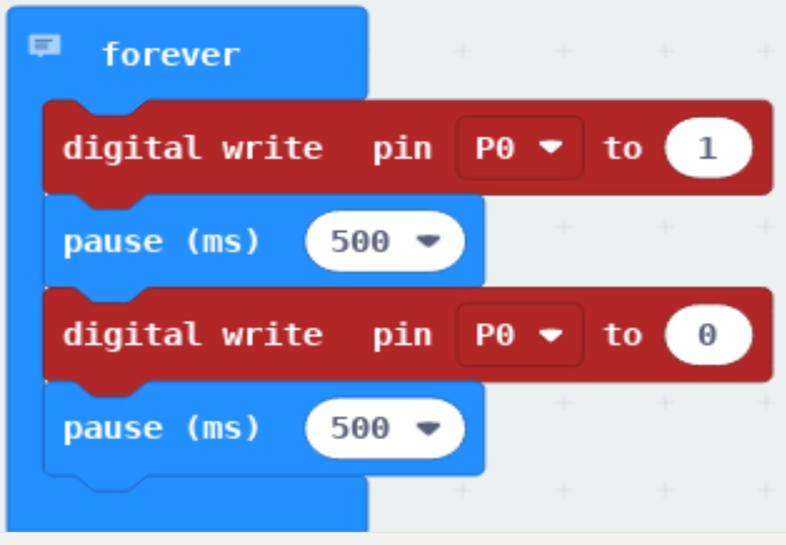
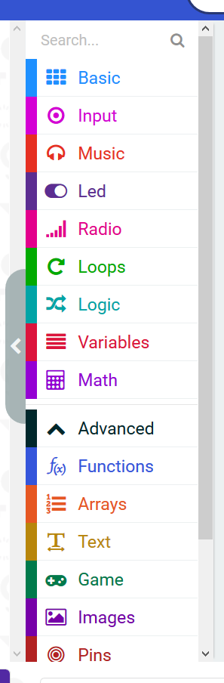
This is your program!
Your drawers
are where you
get your code.

Slide 10
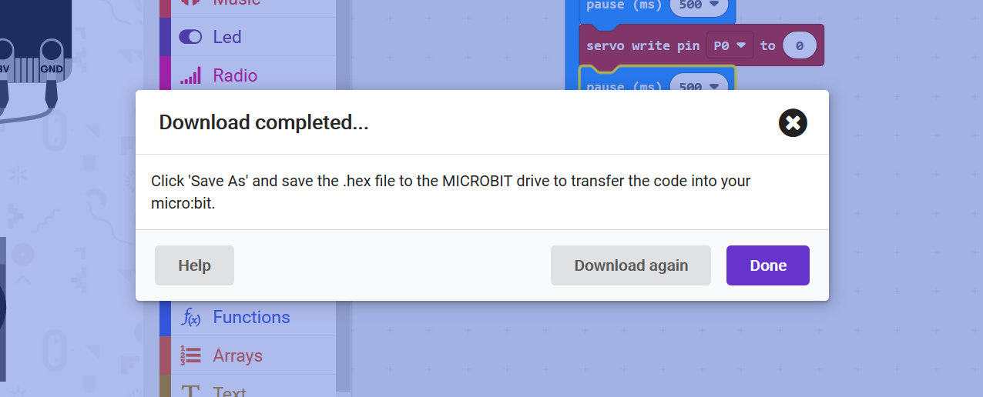
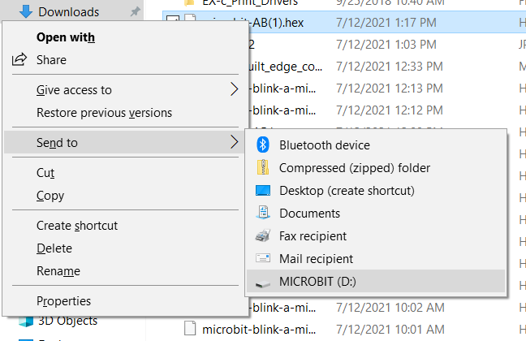
Next download your program to your micro:bit Click download
Find file on your computer (explorer downloads)
Right click
Send to MICROBIT(D:)

Slide 11
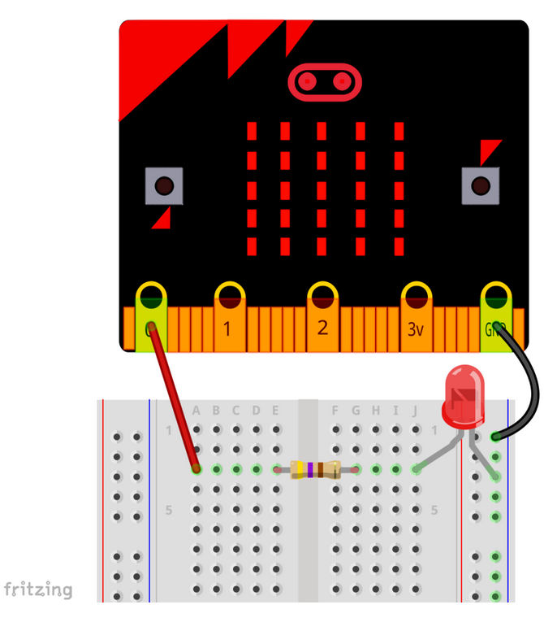
Once you have sent your code to the micro:bit, you need to connect to your LED.
This is an overview show of where we are headed.
You will use an edge connector.
But notice how you are connecting the LED to PIN 0
Completing the circuit
grounding

Slide 12
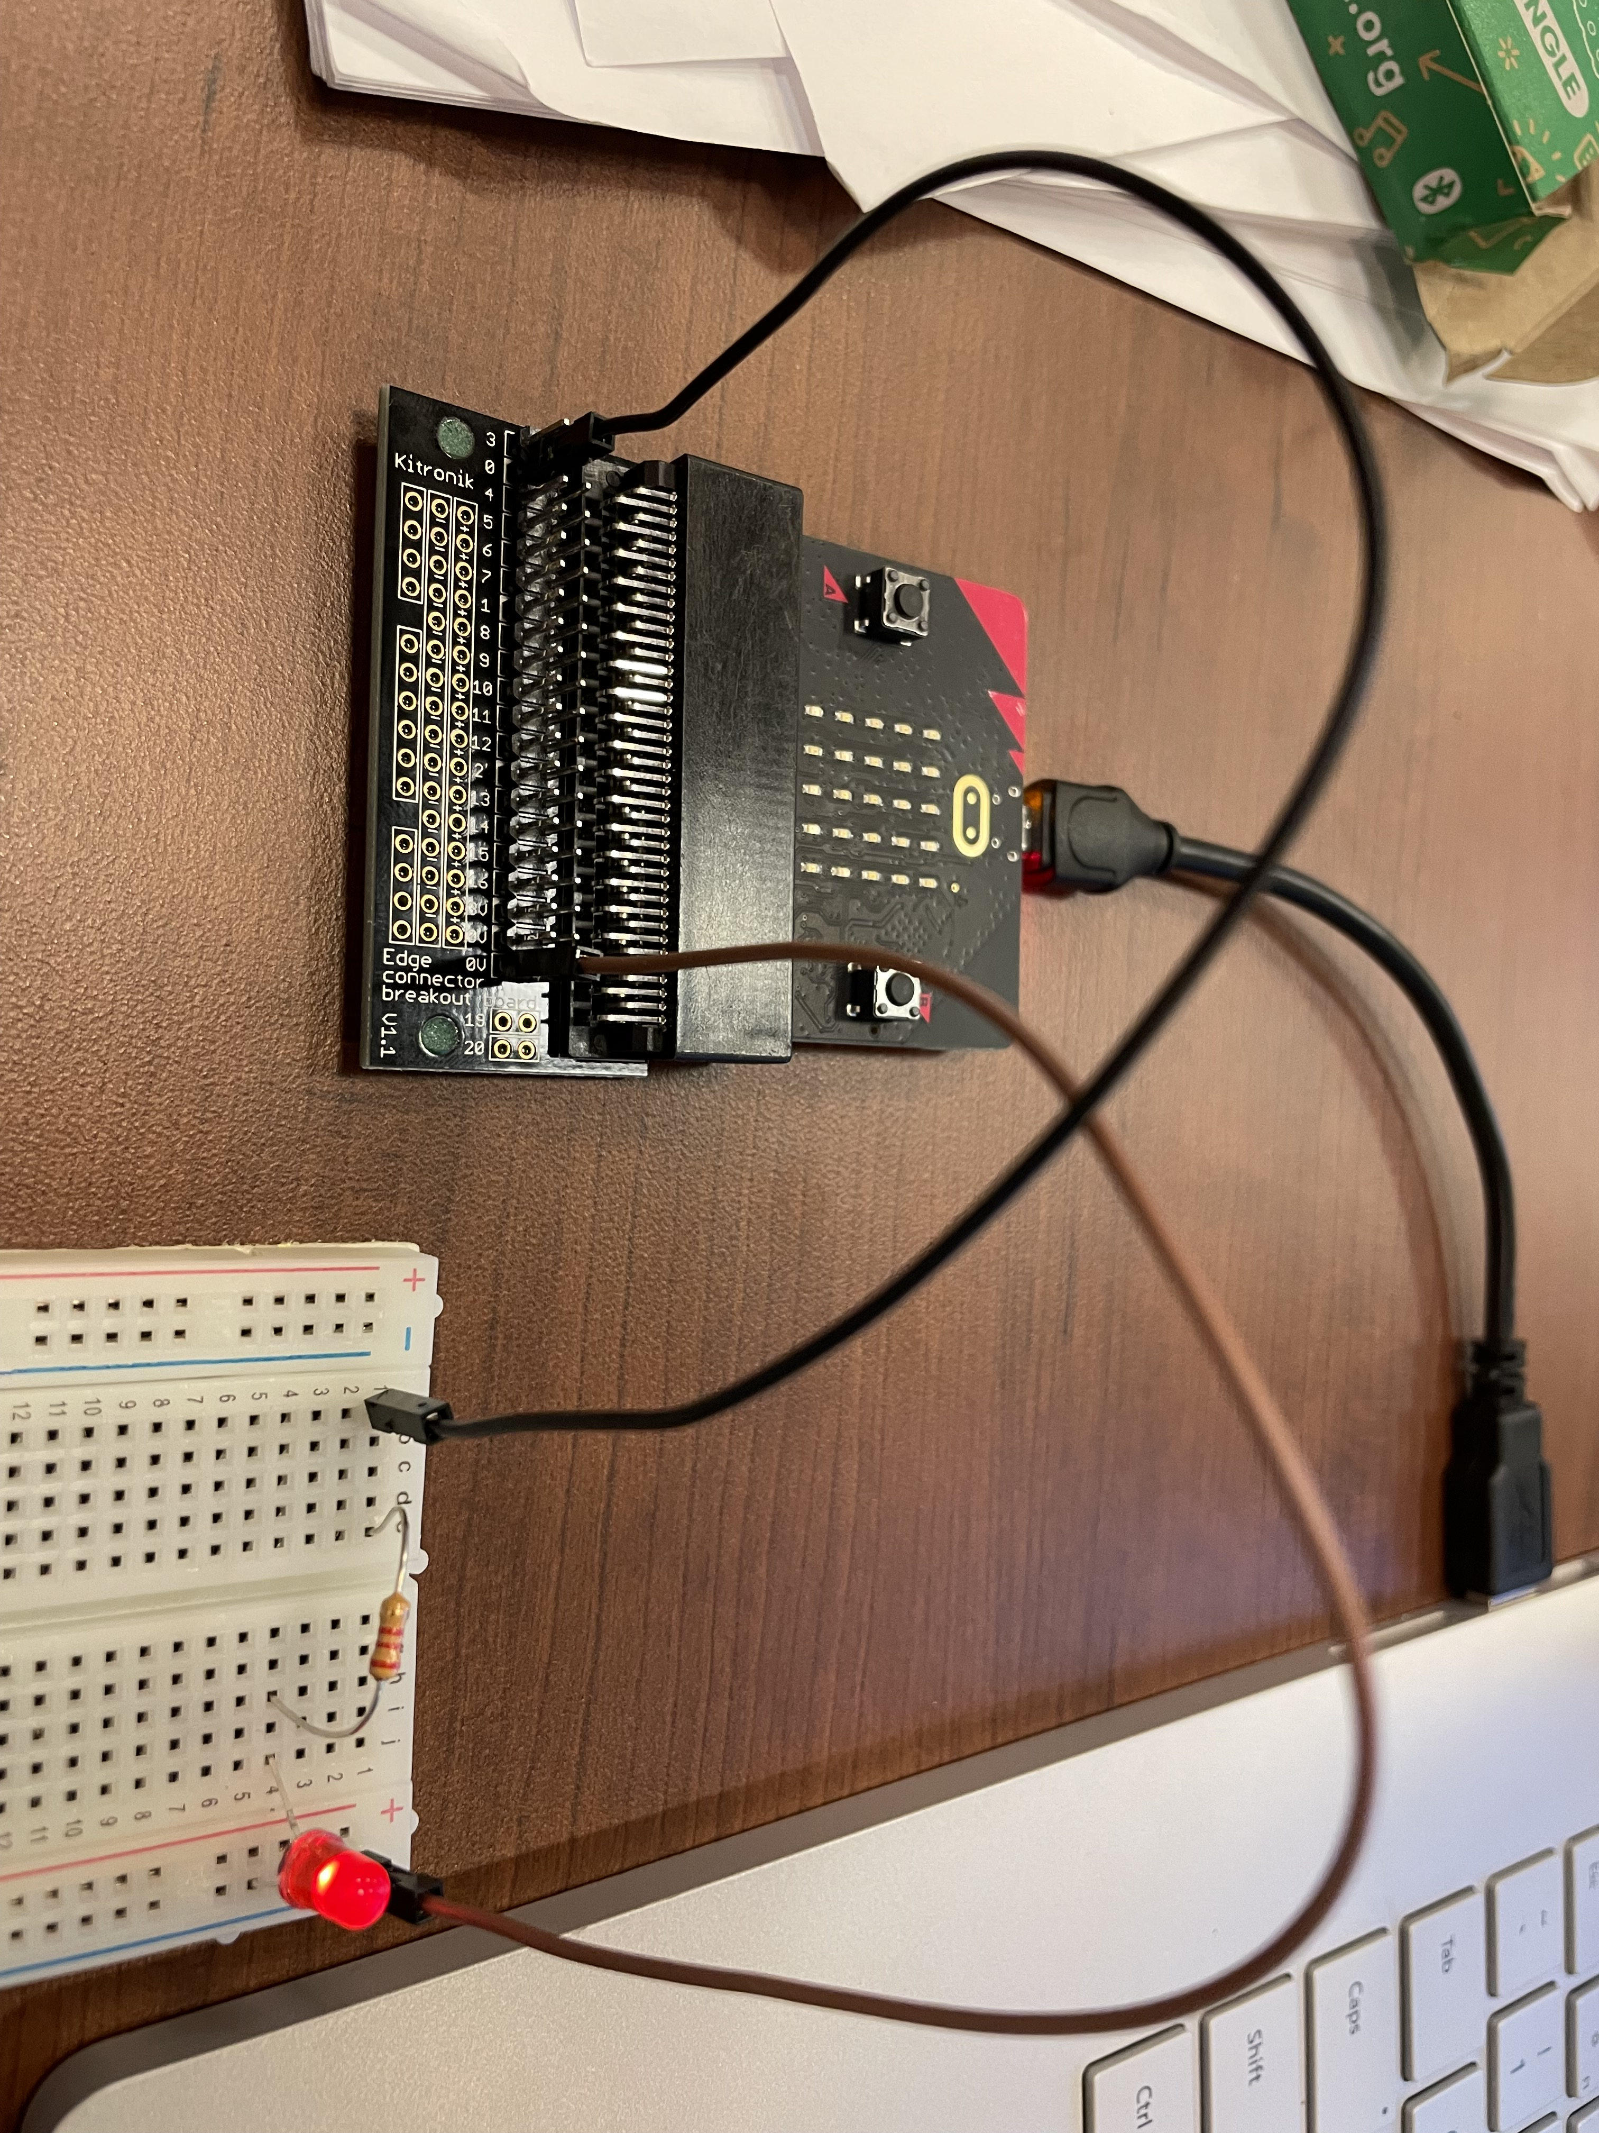
This is where we are going
Attach your edge connector
Grab your breadboard
Grab 2 wires that are male/female
A resistor
An LED

Slide 13
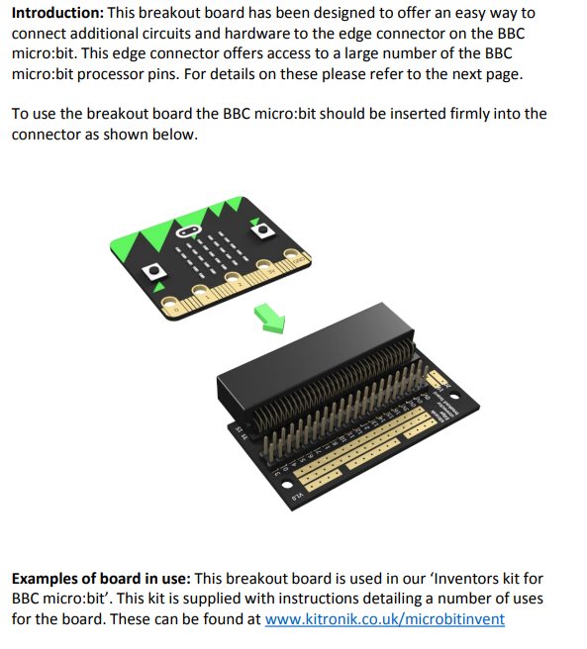
Edge connector
An easy way to connect to hardware.
Insert the edge connector as show.

Slide 14
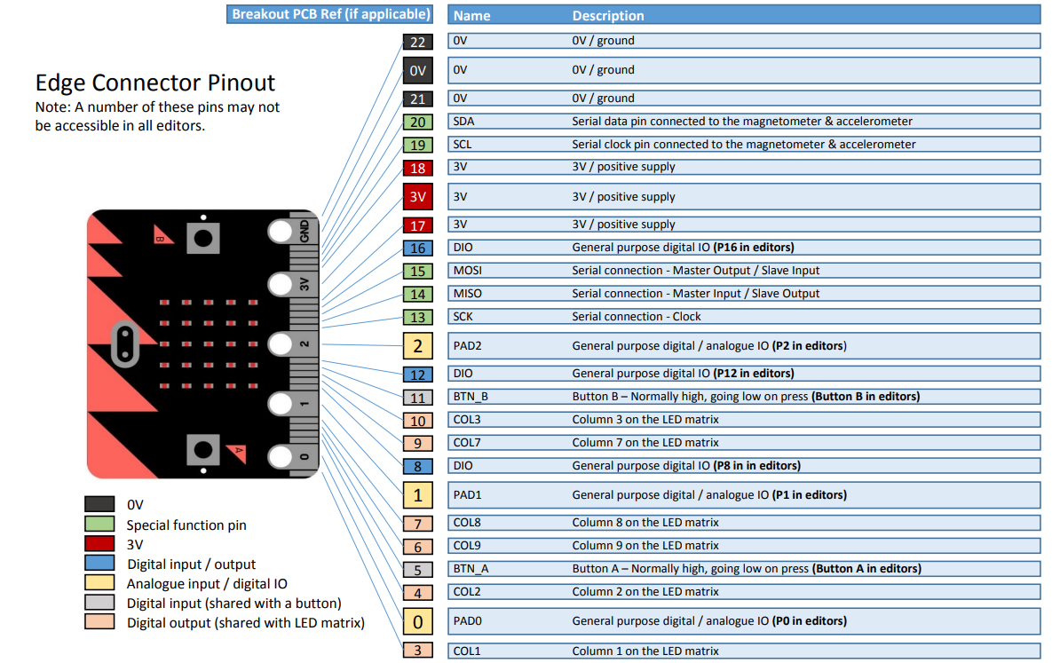
Edge connector pinout

Slide 15
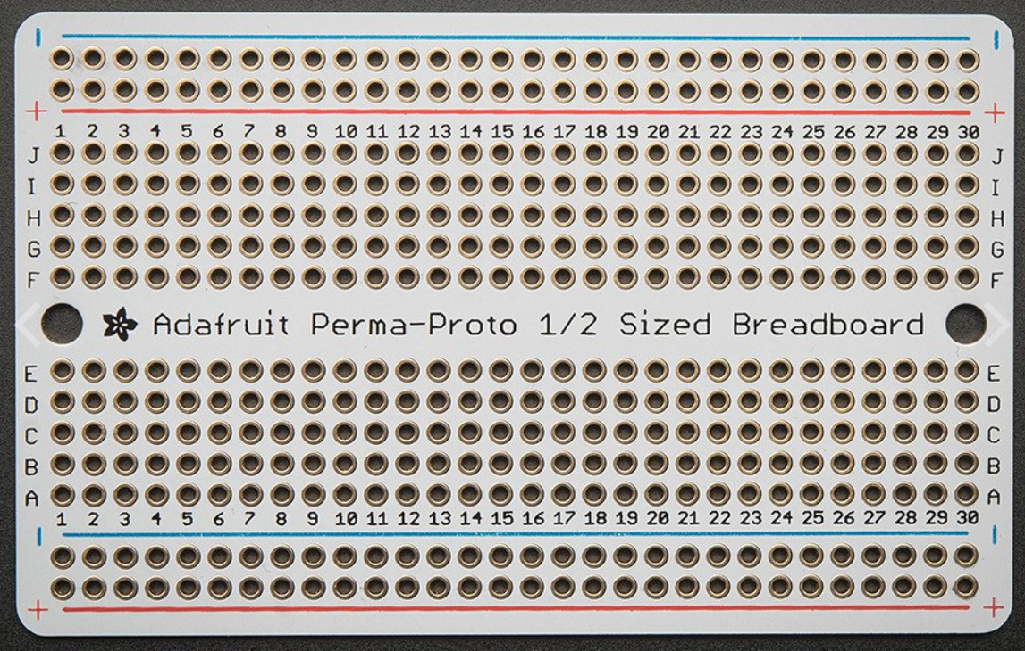
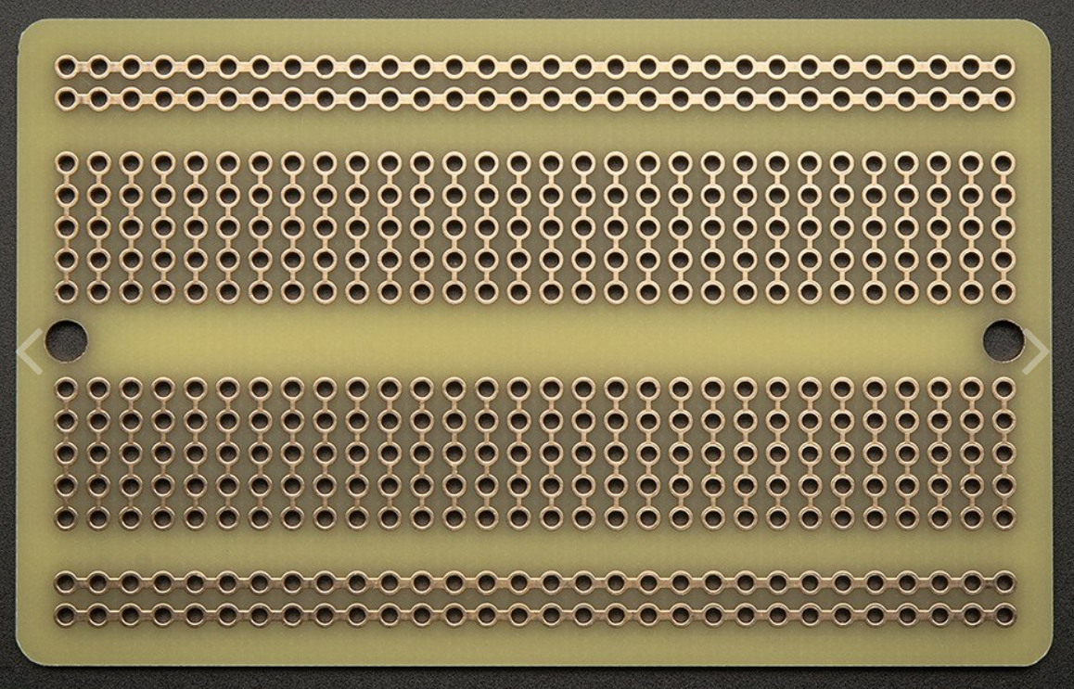
Breadboard wiring

Slide 17
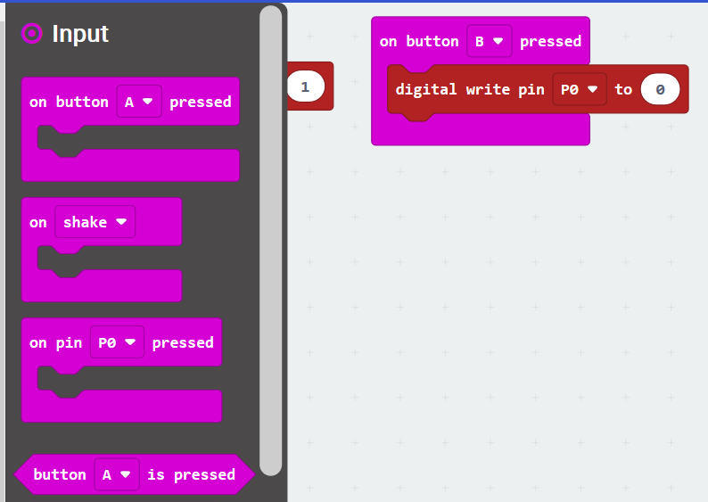
Steps to blink a led with buttons
New project. Drag start to trash
Go to the Input drawer and grab
On button A pressed
Duplicate for
On button B pressed

Slide 18
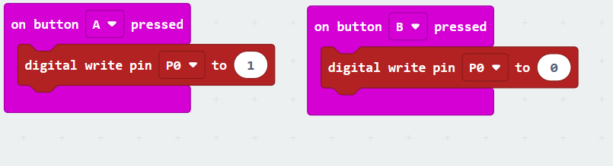
Block Program to use button a and b to blink led

Slide 19
To load your program to your micro:bit Click download
Find file on your computer (explorer downloads)
Right click
Send to MICROBIT(D:)

Slide 20
Use button a to turn on and button b to turn off

